Slide 1
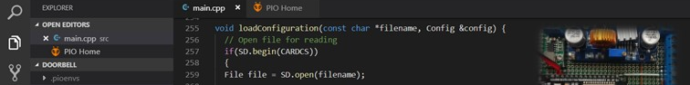
PlatformIO
Microcontroller Development with a Proper IDE

Slide 2
What will we do today?
Install PlatformIO
Introduction to Microcontroller Development
Common Microcontrollers
Introduction to PlatformIO
Create a first demo project (LED blinking)
Work with the library manager
Create a more advanced Project (MQTT Messaging)

Slide 3
Installation
Installing PlatformIO is easy, but takes some time
1
Navigate to: https://platformio.org/platformio-ide
2
Choose your IDE
3
Follow the Instructions
4
Get a coffee
5
Done

Slide 4

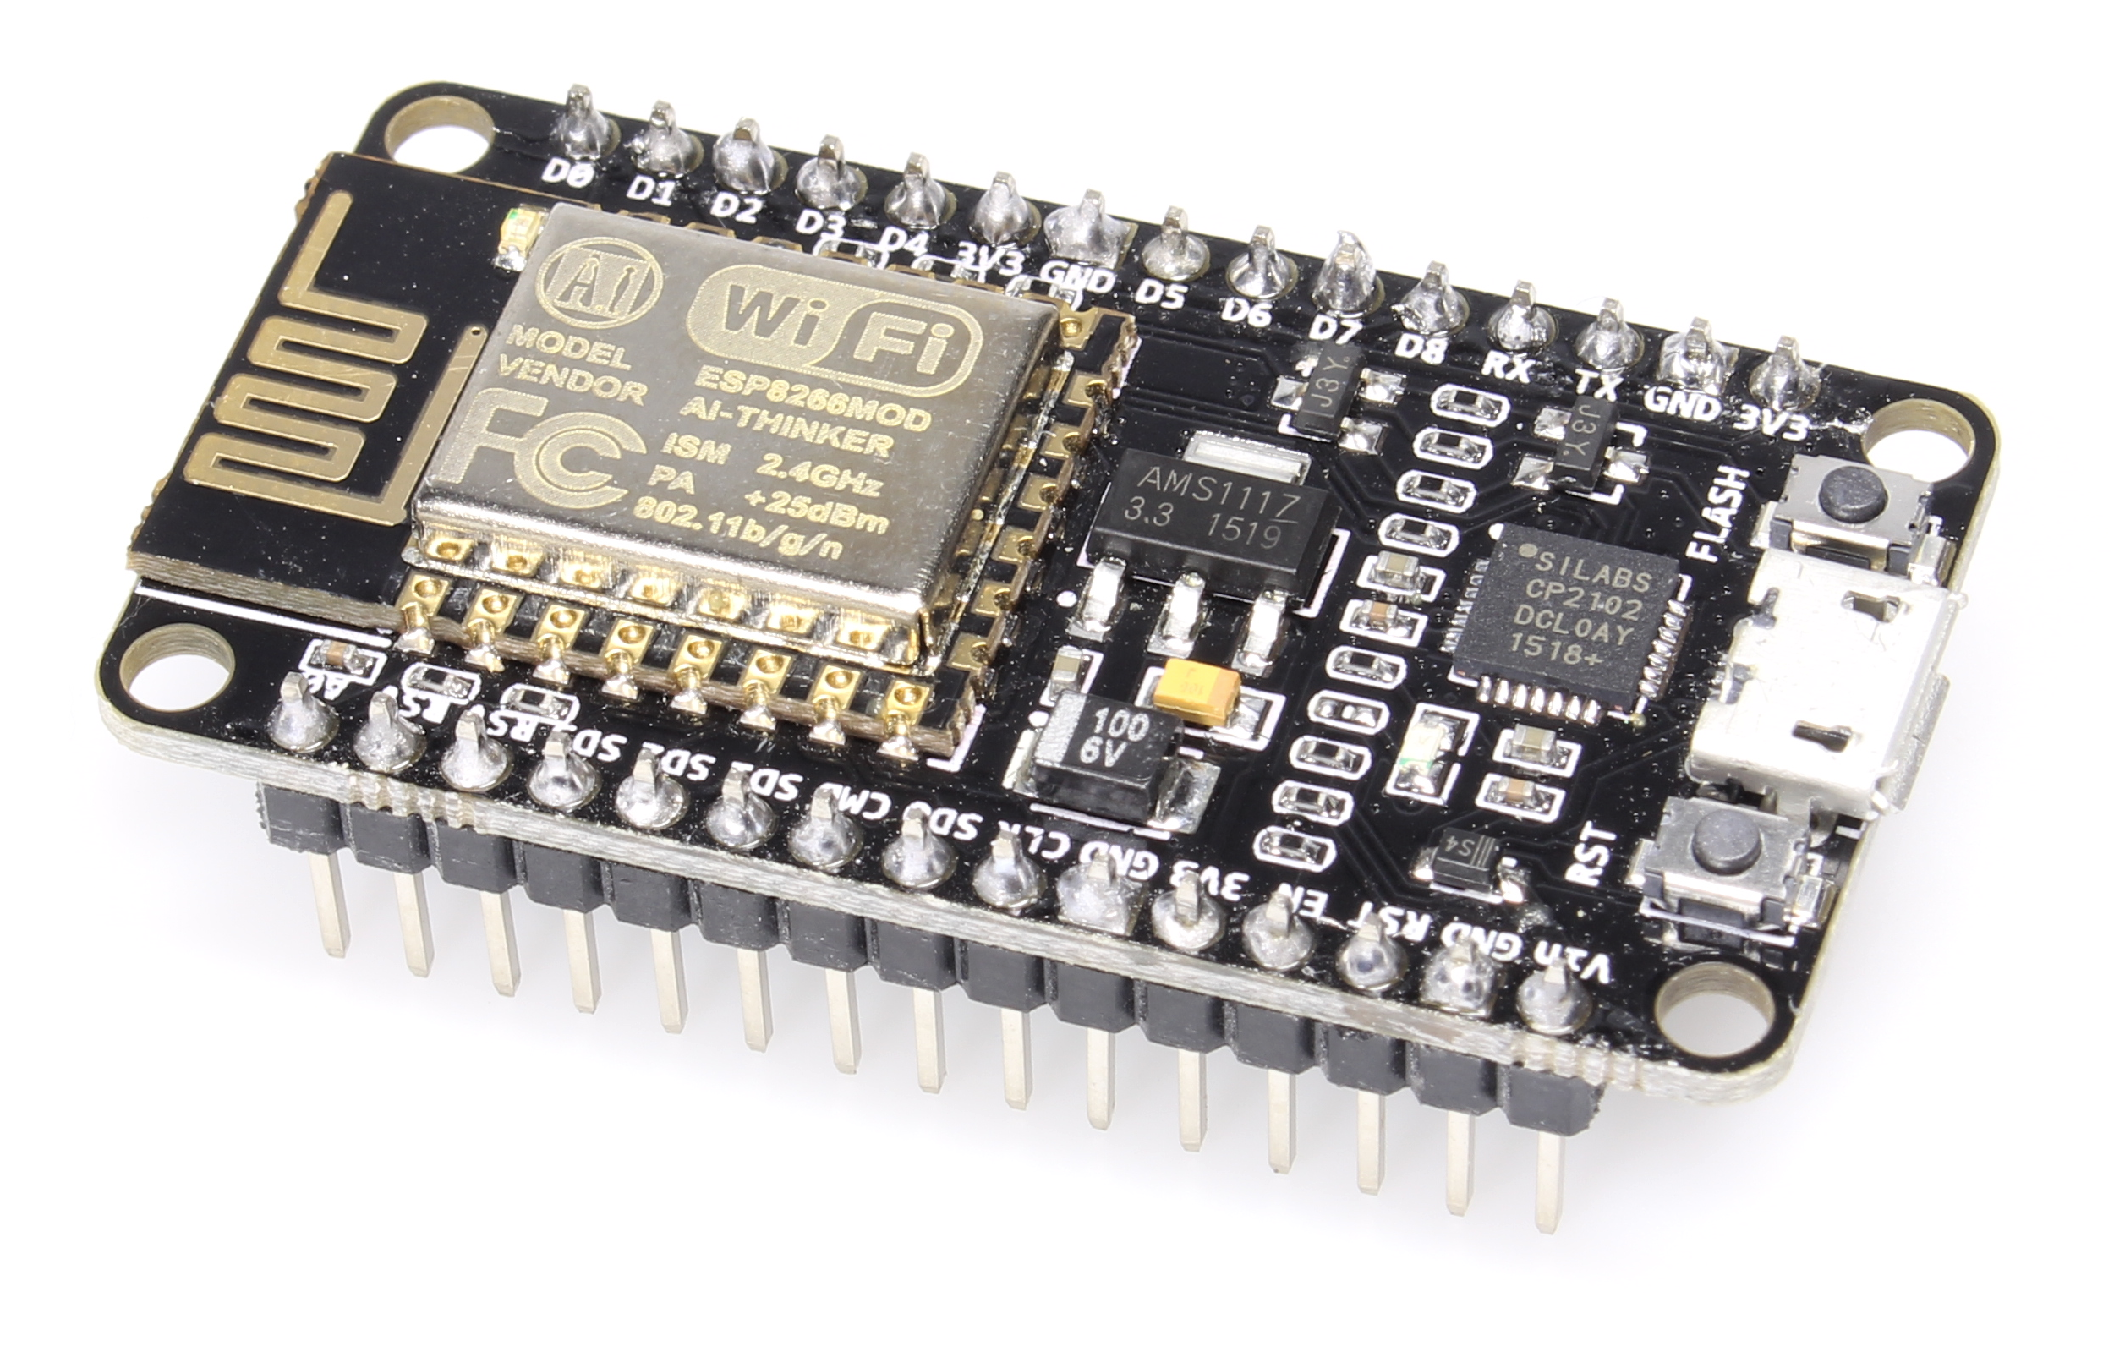
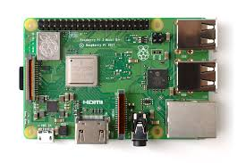
Microcontroller Development
Arduino made microcontrollers popular, but more powerful options exists nowadays.
Arduino
ESP8266
Raspberry Pi
Made Microcontroller development popular
Easy to use hardware
Arduino IDE as Software option
Started as WiFi shield for Arduinos
Great brother: ESP32
80 MHz
10-bit ADC
Single Board Computer
Runs full blown Linux
NOT a Microcontroller!

Slide 5
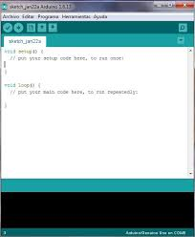
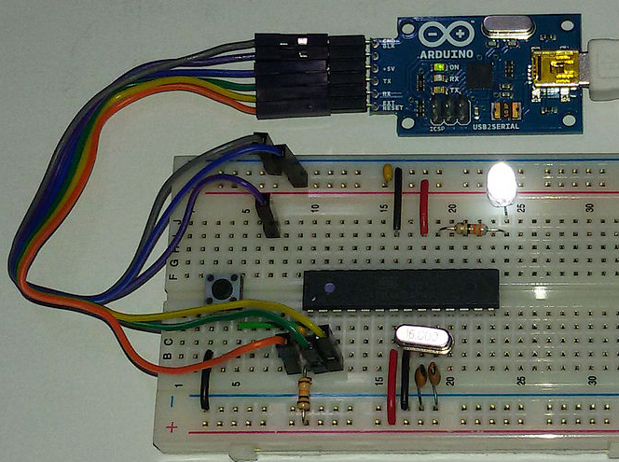
Microcontroller Development
Microcontroller development requires an iterative approach to hard- and software development.

Slide 6
Microcontroller Development
Arduino programs are split into a one-time „setup“ and a recurring „loop“ function
#include <Arduino.h>
void setup() {
Serial.begin(1200);
}
void loop() {
Serial.println("test");
delay(2000);
}
1. Include Arduino.h (Development Framework)
2. „setup()“ defines a function which is executed once at every start of the microcontroller
3. „loop()“ defines a function which is executed in a never ending loop while the microcontroller is powered.

Slide 7
Microcontroller Development
Using c++ as development language, several data types can be used
 | Used for | Syntax | Note | Size
integer | Total numbers | int var = 5; | Integers are signed by default and can overflow: When they reach their maximum value and get increased, they can „flip over“ to their minimum value. | 8-bit
float | Decimal numbers | float var = 5.5; | If doing math with floats, you need to add a decimal point, otherwise it will be treated as an int. | 32 bit
char | Single characters | char var = ‚a‘; |  | 8-bit
string | Text | string var = „text“; | Char-array can be an alternative! | As much as needed
Source: https://www.arduino.cc/reference/en/language/variables/data-types/

Slide 8
Microcontroller Development
Logically, the program can be controlled with if-then-else or switch
If – then – else | Switch
Can be used with any data type that supports logical comparison | Can be used only with int and char
if(a > 0) { Serial.println(“a is positive”); } else if(a < 0) { Serial.println(“a is negative ”); } Else { Serial.println(“a is zero ”); } | switch (someChar) { case 'a': actionOnA; break; case 'x': actionOnX; break; case 'y': case 'z': actionOnYandZ; break; default: actionOnNoMatch; }

Slide 9
Microcontroller Development
For and while loops can be used to iteratively execute program parts
For | While
Executes codes and manipulates a counting variable | Executes code as long as the condition is true
for (int i = 0; i <= 255; i++) { // do something 256 times delay(10); } | while (var < 200) { // do something repetitive 200 times var++; }
Source: https://www.arduino.cc/reference/en/language/structure/control-structure/

Slide 10
Microcontroller Development
Functions can be used for logical seperations of program parts
void loop () {
int i = test();
Serial.println(i);
}
int test () {
return 1;
}

Slide 11
What is PlatformIO?
PlatformIO integrates microcontroller development into existing IDEs
Extension for many regular IDEs
Replacement of the Arduino IDE
Library Manager
Code Manager
Toolchain
Notes:
Folie einbauen Vorstellung ESP8266 & Mehr basics zum Thema DIE (ggf. Bilder zum Thema Microcontroller Programmierung)

Slide 12
Why PlatformIO?
Arduino IDE sucks!
Support for over 200 boards and platforms
Integrated in your favorite IDE
Automated toolchain installation
Library Manager! (Including Updates!)

Slide 13
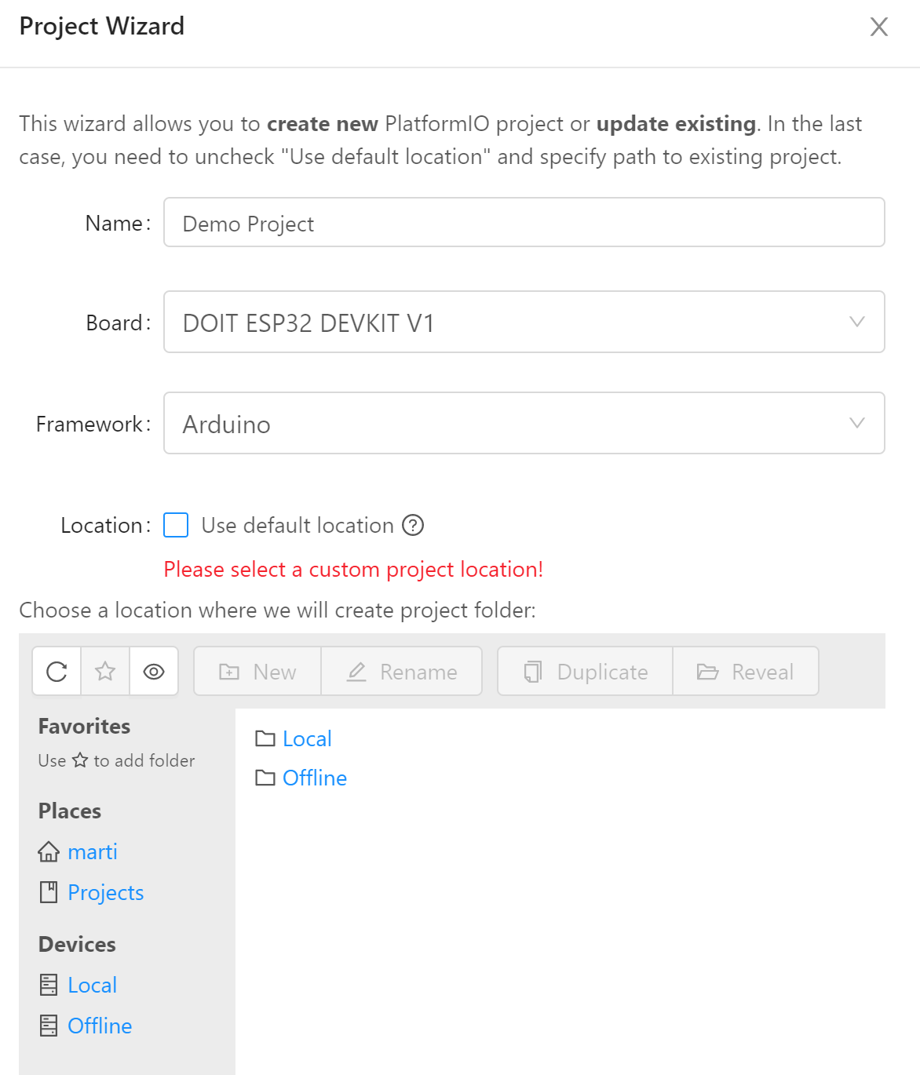
First Project - Start
Creating a new project with PlatformIO is easy due to the offered wizard
PIO Home → New Project
Project Wizard
Name your project
Select your board (You can search)
Select the Framework
Select the Location (or keep default)
Grab a coffee
Switch back to your workspace
Open src → main.cpp

Slide 14
First Project – Code
/*
* Blink
* Turns on an LED on for one second,
* then off for one second, repeatedly.
*/
#include <Arduino.h>
void setup()
{
// initialize LED digital pin as an output.
pinMode(LED_BUILTIN, OUTPUT);
}
void loop()
{
// turn the LED on (HIGH is the voltage level)
digitalWrite(LED_BUILTIN, HIGH);
// wait for a second
delay(1000);
// turn the LED off by making the voltage LOW
digitalWrite(LED_BUILTIN, LOW);
// wait for a second
delay(1000);
}
Include Arduino.h
In your setup():
Define LED_BUILTIN as output
In your loop:
Turn LED_BUILTIN low
Wait 1 second
Turn LED_Builtin High
Wait 1 second

Slide 15
First Project – platformio.ini
Contains your project settings
Autogenerated, but can be adjusted
Important addtions:
upload_port
Specifies the port to upload the code to
Can be a COM port (for serial uploads)
Can be a hostname (OTA updates)
monitor_port
Specifies the serial port to monitor
For debugging
lib_deps
Tells the IDE, which libraries are needed
[env:esp32doit-devkit-v1]
platform = espressif32
board = esp32doit-devkit-v1
framework = arduino
upload_port = COM5
monitor_port = COM5
lib_deps =
ArduinoJson

Slide 16
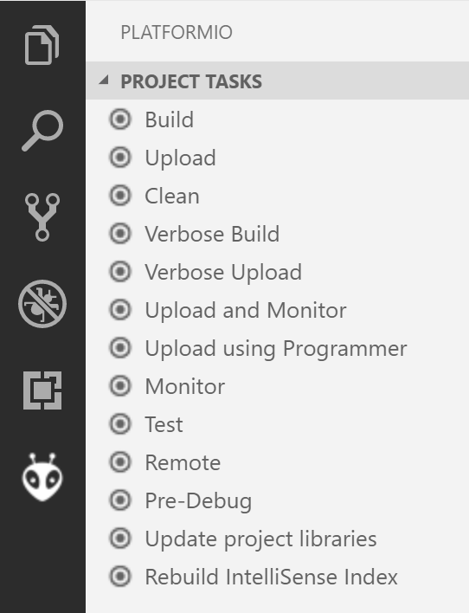
First Project – Build and Run
Use the Toolbar:
Or: Use the PIO Button (See right)
Build (and check the results)
Upload to the board
Enjoy a blinking LED (or start debugging)

Slide 17
Library Manager - Install
PIO Home → Libraries
Search, Install and Update libraries
Example: Search for „PubSubClient“
This is the most reliable MQTT Implementation
Click on the library
Hit „Install“
Check the examples!

Slide 18
Library Manager – Install via git
Sometimes a library is not in the manager
Sometimes you need a fork
Example: VS1053 Fork for the ESP
https://github.com/danclarke/Adafruit_VS1053_Library
Go to the Library Manager
Click „install“ (without searching)
Enter the URL for the git repo
Note: This puts the library into .piolibdeps
→NOT shared on git!

Slide 19
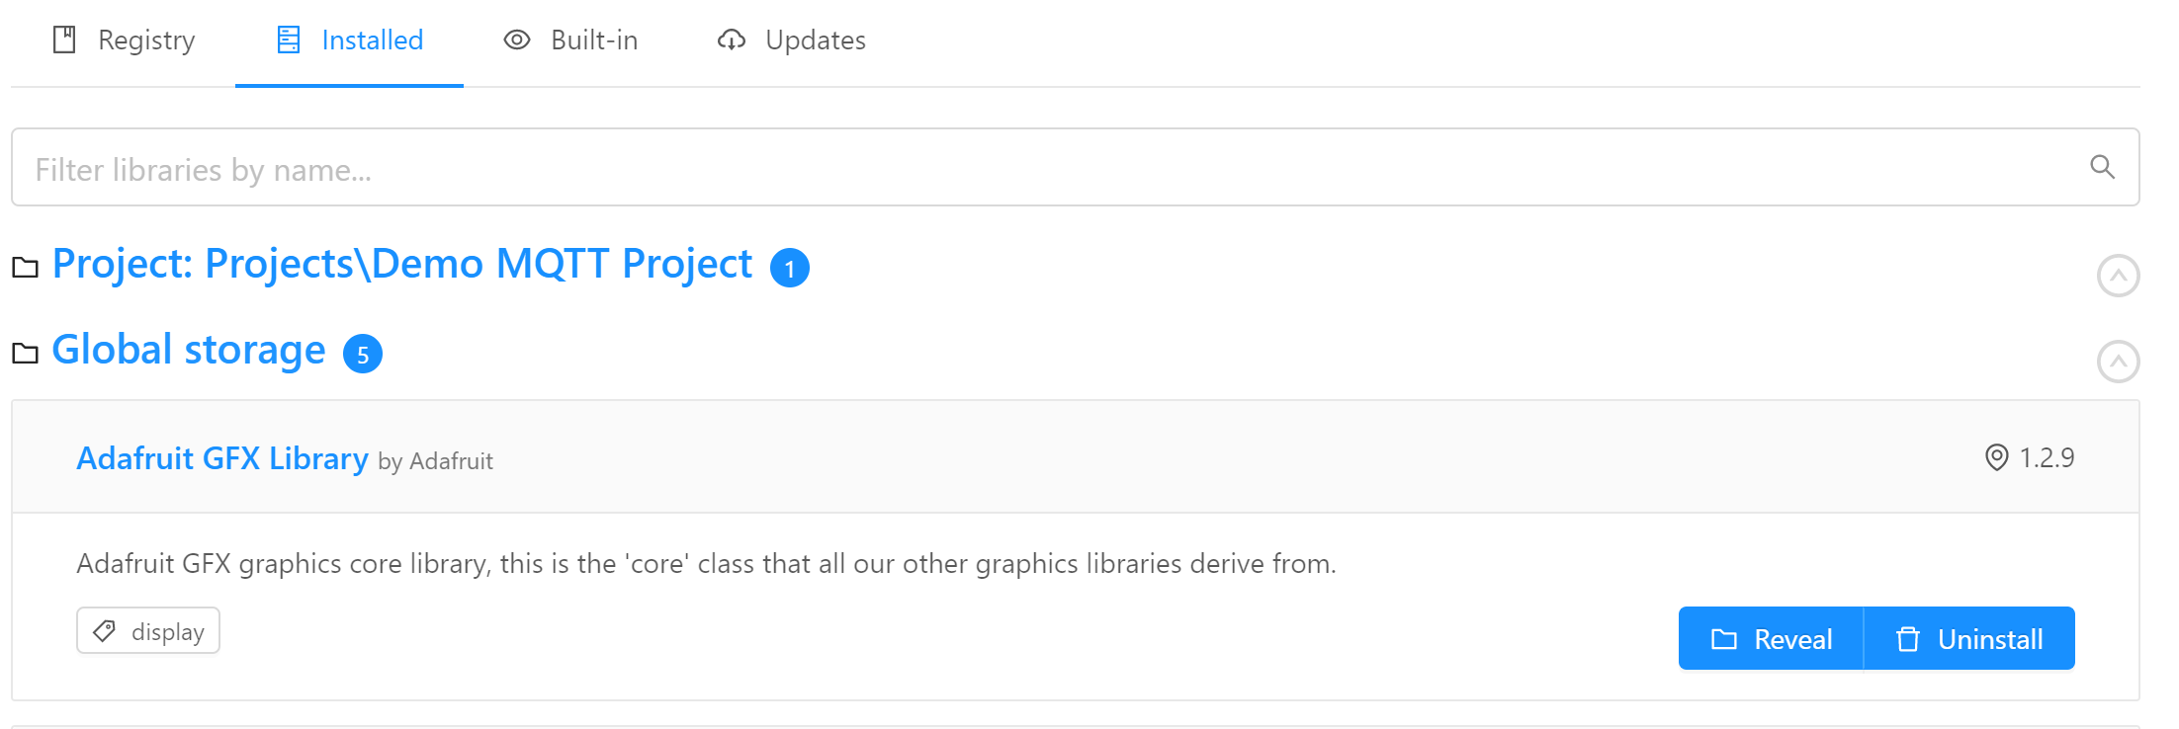
Library Manager – Installed Libs
Get an overview on installed libraries
Access examples
Global Storage & Project Storage

Slide 20
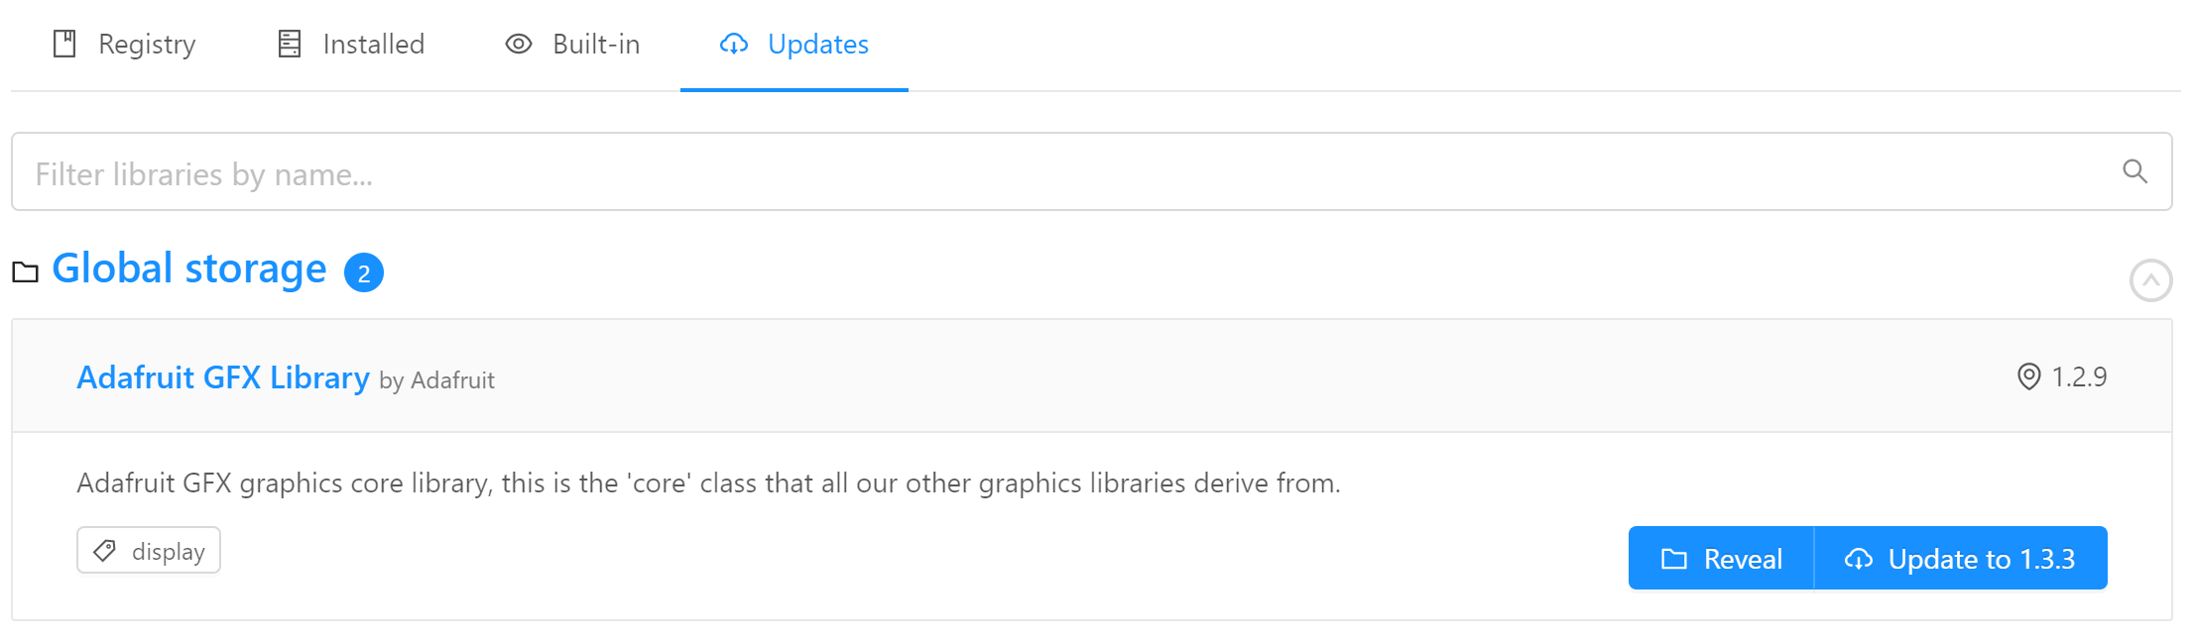
Library Manager – Update Libs
Automatic detection of updates
Update library with 1 click

Slide 21
Next Project – MQTT Messaging
MQTT is a lightweight messaging protocol
Central Broker (server) handles messages
Clients:
Subscribers can subscribe to topics
Publishers can publish messages to topics
Used widely in IoT applications

Slide 22
MQTT Project – Structure
WiFi SSID: „CoMakingSpace“
Password: just ask ;)
mqtt_server = "comakingcontroller"
Based on the Example from the library!
Connect to the WiFi
Setup:
Connect to the MQTT Server
Subscribe to your topics
Loop:
Handle messages: client.loop();
Publish something
Notes:
Folien einbauen zum debuggen via Serial Port

Slide 23
Thank you!
Notes:
Aufgaben einbauen zur Interaktion mit Sensoren / der echten Welt

Slide 24
Stay in Touch
www.comakingspace.org
wiki.comakingspace.org
github.com/comakingspace

Slide 25








Stay in Touch
Like us on Facebook
facebook.com/comakingspace
Check Our WebSite
www.comakingspace.org
Follow us on Twitter
@comakingspace
Get informed on our Wiki
wiki.comakingspace.org
Follow us on Instagramm
instagram.com/comakingspace/
Help with coding and other issues
Github.com/comakingspace
Sign up for our newsletter:
https://lists.schokokeks.org/mailman/listinfo.cgi/comaking-news
Join the Heidelberg Makers WhatsApp Group
⚙Maker Community HD⚙
https://chat.whatsapp.com/AXuJcYqno64CUjsWsEmma4

Slide 26

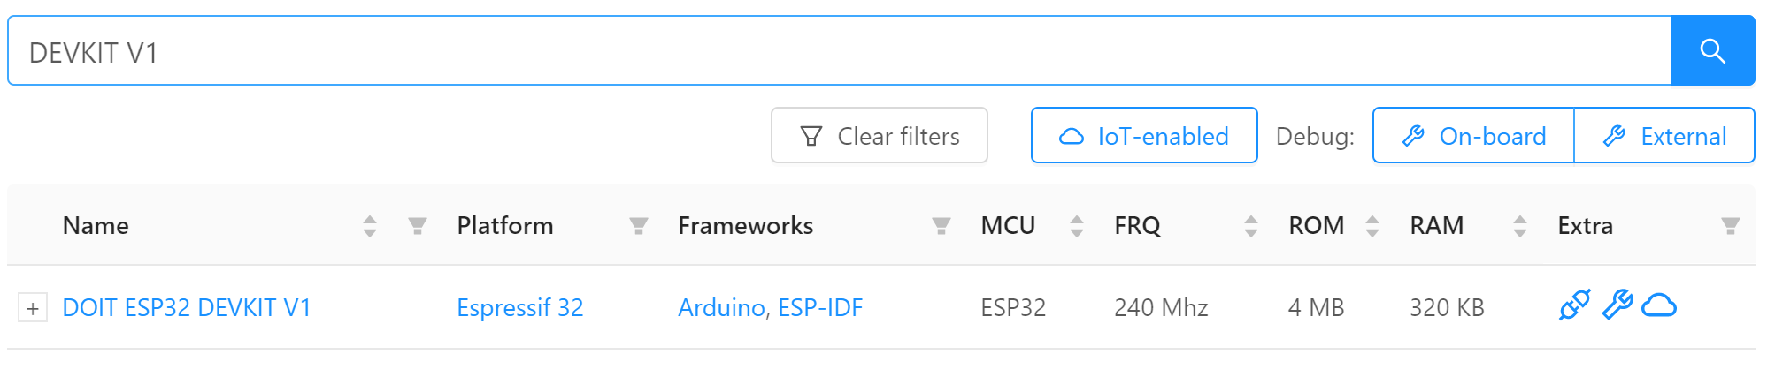
Preperation – Platform Installation
PIO Home should have opened automatically
If not, reload your IDE or press:
Switch to „boards“
Search for your board (e.g „Devkit V1“)

Slide 27
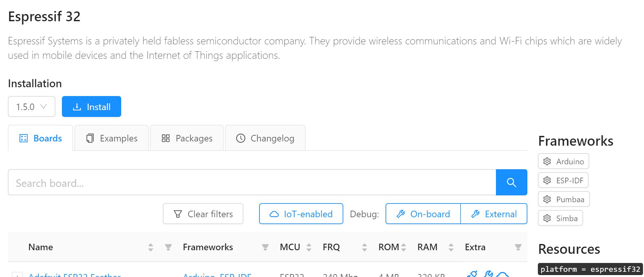
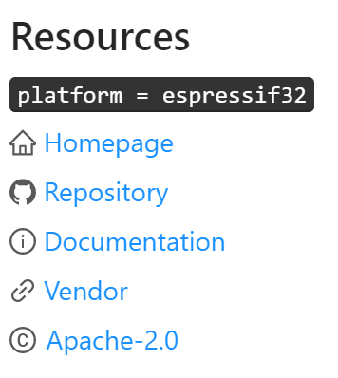
Preperation – Platform Installation
Click on the platform name
Hit „Install“

Slide 28
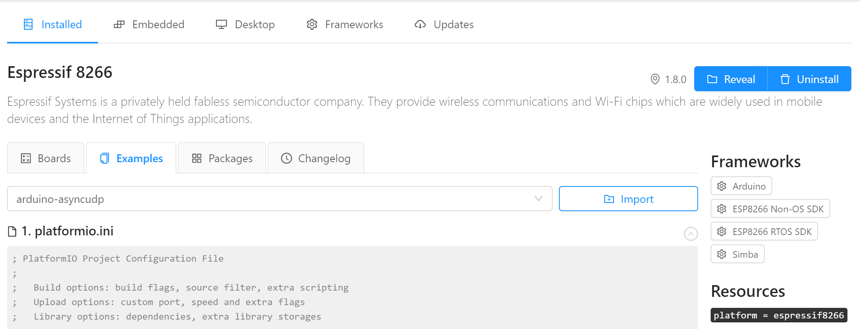
Preperation – Platform Installation
Check the examples to get familiar with your platform:

Slide 29
Microcontroller Development
Data type
What is it?
int var = val;
Integers are signed by default and can overflow: when they reach their maximum value and get increased, they can „flip over“ to their minimum value.
Integers are your primary data-type for number storage
Integer
Syntax
Note

Slide 30
Microcontroller Development
Integer
Float
Char
String
Primary data-type for storing total numbers
Primary data-type for storing decimal numbers
Primary data-type for storing characters
Primary data-type for storing text
Syntax
Syntax
Syntax
Syntax
int var = 5;
float var = 5.5;
char var = ‚a‘;
string var = „text“;
Note
Note
Note
Note
Integers are signed by default and can overflow: when they reach their maximum value and get increased, they can „flip over“ to their minimum value.
If doing math with floats, you need to add a decimal point, otherwise it will be treated as an int.
-
Char-array can be an alternative!

Slide 31
Microcontroller Development
Integer | Float | Char | String
Storing total Numbers | Storing decimal numbers | Storing ASCII characters | Storing text
int var = 5; | float var = 5.5; | char var = 'a'; | string var = "text";
Integers are signed by default and can overflow: when they reach their maximum value and get increased, they can „flip over“ to their minimum value. | If doing math with floats, you need to add a decimal point, otherwise it will be treated as an int. |  | Char-array can be an alternative!

